Slide 1
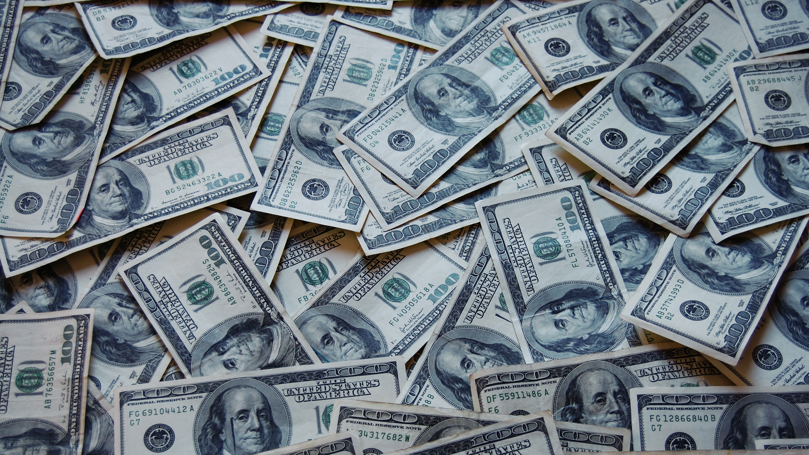
Plutocracy
Parker Orne

Slide 2

Annotated Bibliography
Wikiquote.com Plutocracy https://en.wikiquote.org/wiki/Plutocracy. A Plutocracy is a form of government where the top percent of the wealthiest people rule.
Wikiquote is a part of wikipedia therefore it may not be reliable as people can change things.
Politico.com defines Plutocracy as an Empire ruled by the wealthiest people. “Search.” POLITICO, www.politico.com/search?q=plutocracy.
Politico is a reliable source because it is a political site so it tells news from either side so it might not be as biased.
Theguardian.com Birrell, Ian. “Plutocrats: The Rise of the New Global Super Rich by Chrystia Freeland – Review.” The Observer, Guardian News and Media, 1 Nov. 2012, www.theguardian.com/books/2012/nov/01/plutocrats-super-rich-freeland-review. government based solely on the decisions of the wealthy.
The Guardian is a reliable source because it is reporters answering questions based on information they have found. This means that it could be biased.
Avent, Ryan. “The Causes and Consequences of Plutocracy.” Reuters, Thomson Reuters, 17 Oct. 2012, blogs.reuters.com/great-debate/2012/10/17/the-causes-and-consequences-of-plutocracy/. A form of government that isolates the wealthy to be the ruler.
Reuters.com is a viable source because it is people who post blogs about the questions asked. But with this there can definitely be a lean to a certain side.
Plutocracy.” Investopedia, 4 Nov. 2012, www.investopedia.com/terms/p/plutocracy.asp. Form of government run exclusively by the wealthy whether directly or indirectly.
Investopedia is a great source of knowledge and although it may lean it is viable in business talk and the people who post are reliable.
“Plutocracy.” Wikipedia, Wikimedia Foundation, 10 Apr. 2018, en.wikipedia.org/wiki/Plutocracy. A society controlled by a function of wealth.
Wikipedia can be unviable sometimes because people can go on the site and change the definitions and answers.
These definitions can be biased because each of the definitions are from different sites. Each site can either be neutral, left leaning, or right leaning. Bias if these sites can distort the real definition with what they think the side they are on feels about it.

Slide 3
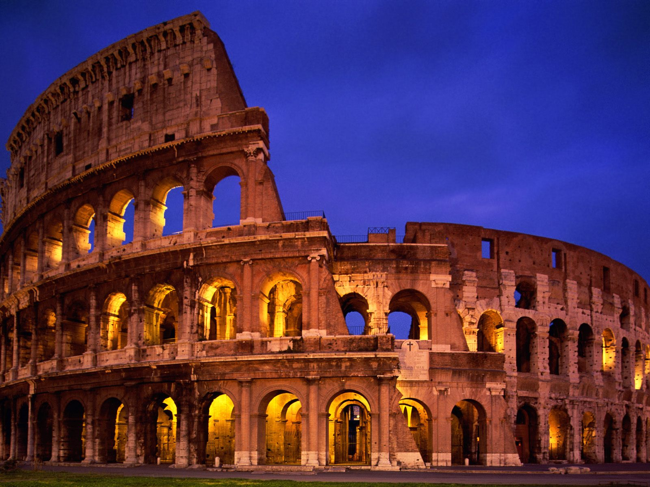
Examples of a Plutocracy
A Plutocracy is a form of government where a country or state is ruled by the most richest people in that country or city. Examples of a Plutocracy is dated back all the way to the Roman Empire, and Carthage. In Carthage kings were elected by auctions and the highest bidder were elected and in Rome most of the time you had to be born into royal family in order to be a king. Modern examples is the city of London where more than 2/3 of the votes are non-residential and mostly by businesses and companies. This shows the difference between the lives of the wealthy and the poor.

Slide 4

Examples of a Plutocracy
A fictional example of a Plutocracy is the Purge movies. The president isn't necessarily the only wealthy one but is still has power. The wealthy people of the country do not have to participate in the purge event and they can also request people to hunt and bring poorer people to their house for them to kill so they will not risk being killed themselves. Poor people can also sacrifice themselves to the rich people and in return their family will be paid by the wealthier family. This shows the gap between the wealthy and the poor and how it can affect people differently. Everyone has to participate but it is different for everyone.

Slide 5
How does Plutocracy affect a country? Is it good or bad?
Some people believe that Plutocrats even if they do not succumb to the wealthy life are still separate from the rest of the country because they have something to lean back on.
There have always been people like this but the difference now is that these people have been able to accumulate more and more money than before.
These Plutocrats are more likely to feel deserving of rewards.
If a country is a Plutocracy the Plutocrats will most likely make policies to assist the wealthy, the concern will magnify the wealthy and will create even more of an income inequality.

